Slide 1

EMPLOYEE MANAGEMENT SYSTEM
DONE BY,
SUBBA REDDY GOGGULAMUDI,
NARENDRA REDDY KASHANA,
VEERA RAJA MOHAN REDDY MALLIREDDY

Slide 2
Agenda
Objective of the Project
ER Diagram and schema explanation
Key analysis questions (use cases)
SQL query results with screenshots or summaries
Final business insights and recommendations
Conclusion (Key finding overall)
Your Experience/Challenges working on SQL – Data Analysis Project.

Slide 3
Objective of the Project:-
Efficient tracking:
The system is designed for the efficient tracking of employee details, job assignments, qualifications, and performance metrics.
Information management:-
It stores and manages personal details like contact information, gender, and login credentials, ensuring secure access and retrieval of records.
Job role assignment: -
The system ensures employees are correctly aligned with their functions and responsibilities by associating them with specific job roles and departments.
Departmental structure management:-
It manages the various departments within the organization and the employees assigned to them.
Automation and efficiency: -
The project aims to automate manual processes to reduce errors, eliminate repetitive tasks, and provide a more economical and safer means of storing.

Slide 4
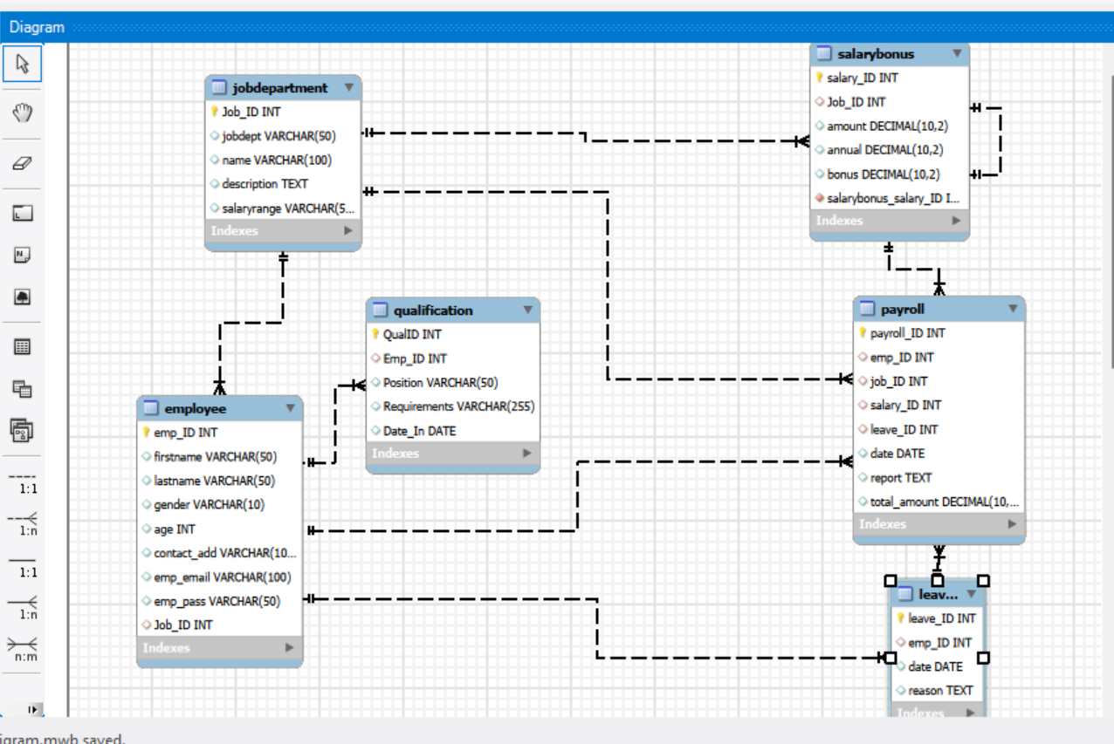
ER-DAIGRAM:-
The diagram models an HR management system.
Employee stores staff details, linking to job department, qualification, and leaves.
Job department defines roles and departments.
Qualification lists employee qualifications.
Leaves records employee leave details.
Salary bonus specifies pay and bonuses for each job.
Payroll calculates pay, combining job, salary, and leave data.

Slide 5
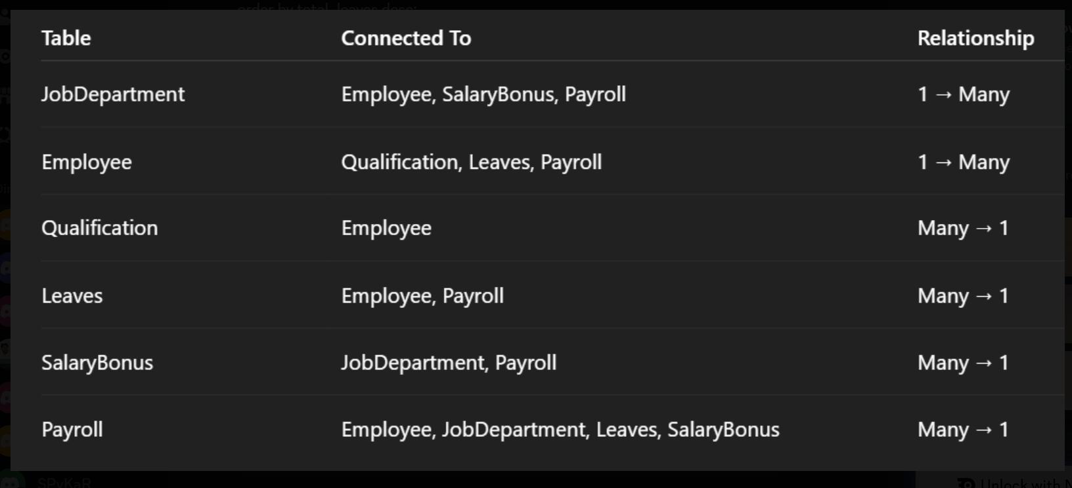
ER-DAIGRAM RELATIONSHIP:-

Slide 6
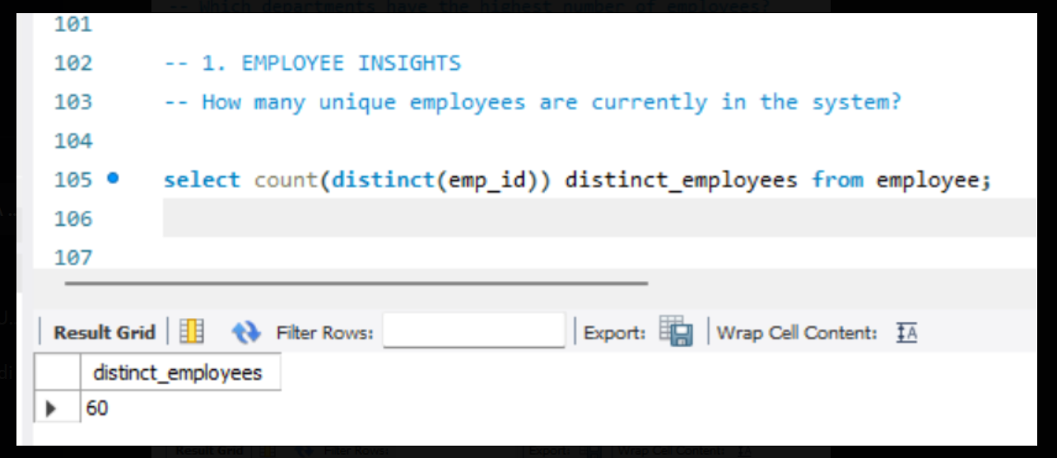
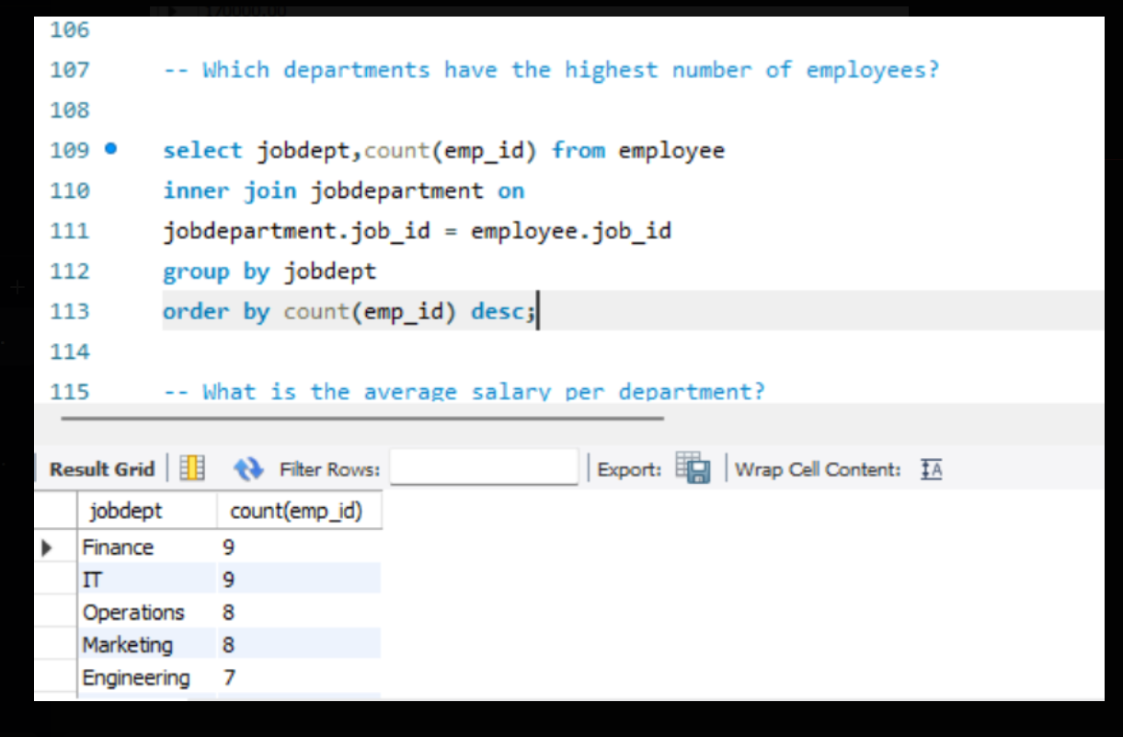
Key analysis questions:
1. EMPLOYEE INSIGHTS;-
How many unique employees are currently in the system?
Which departments have the highest number of employees?

Slide 7
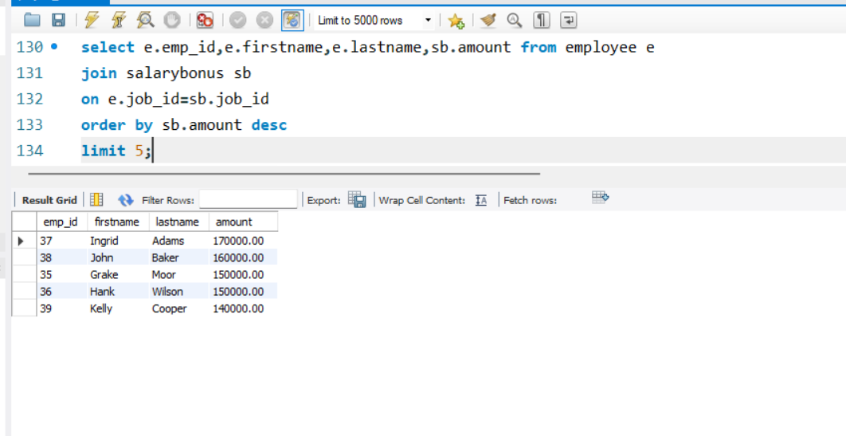
Who are the top 5 highest-paid employees?

Slide 8
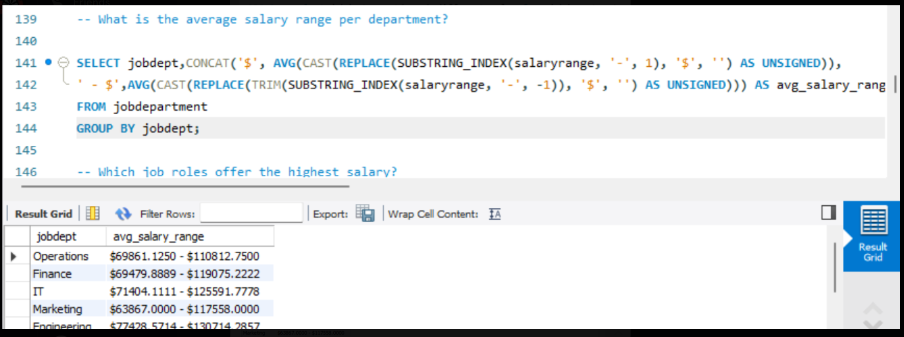
2. JOB ROLE AND DEPARTMENT ANALYSIS:-
What is the average salary range per department?

Slide 9
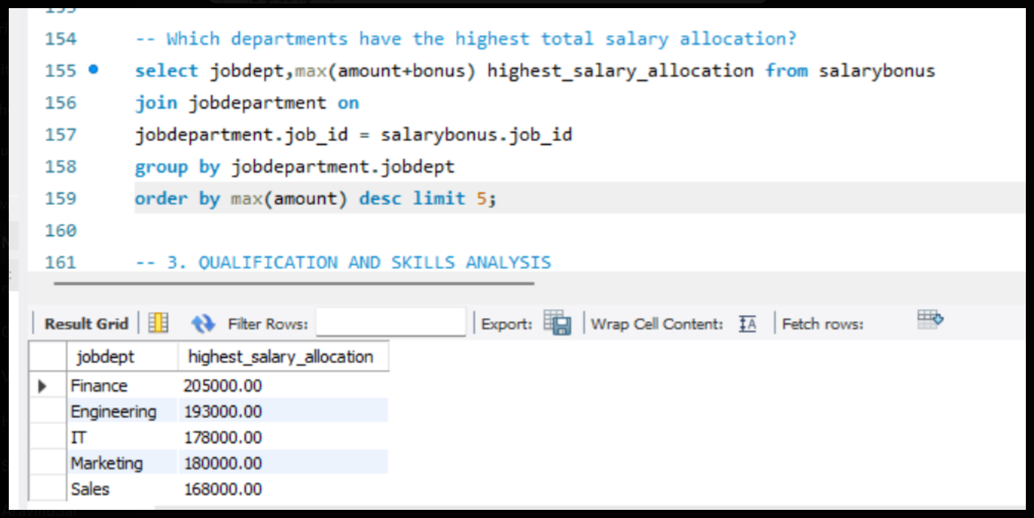
Which departments have the highest total salary allocation?

Slide 10
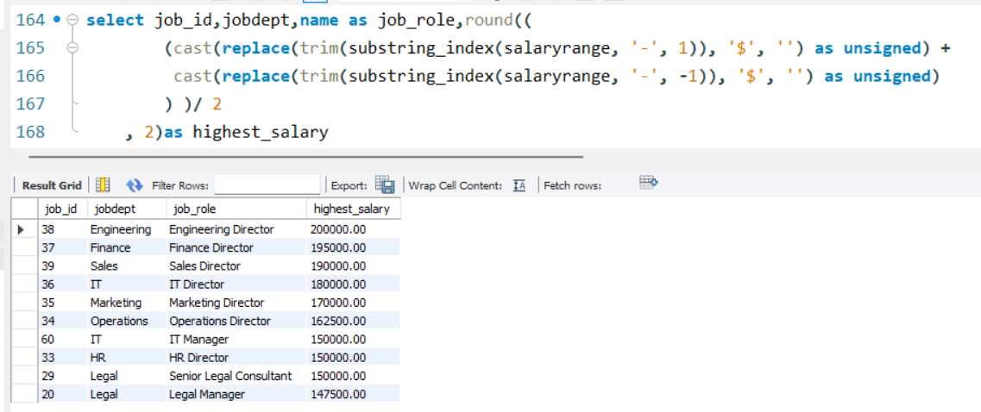
Which job roles offer the highest salary?

Slide 11
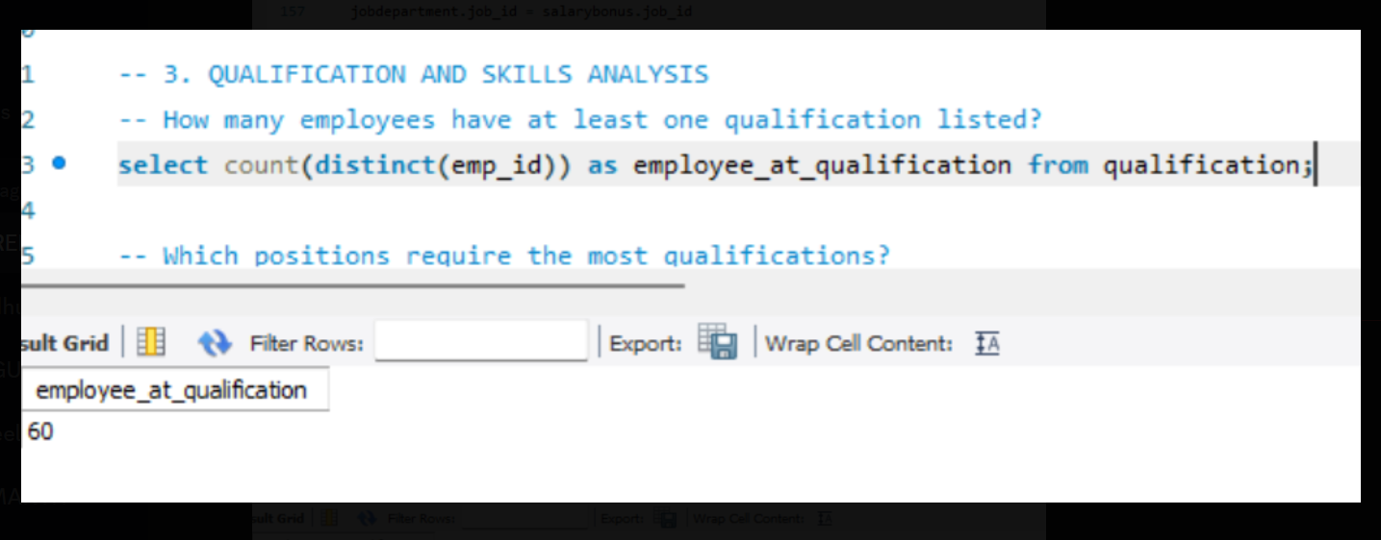
3. QUALIFICATION AND SKILLS ANALYSIS
How many employees have at least one qualification listed?

Slide 12
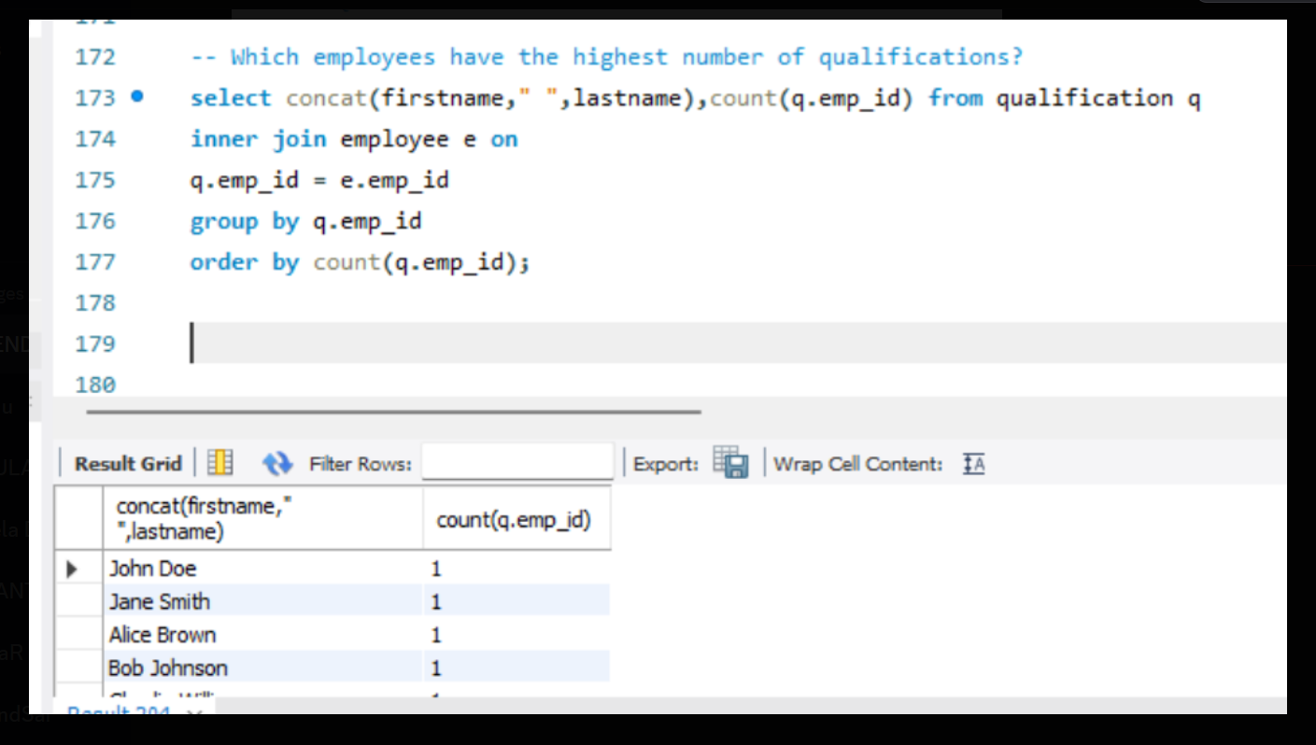
Which employees have the highest number of qualifications?

Slide 13
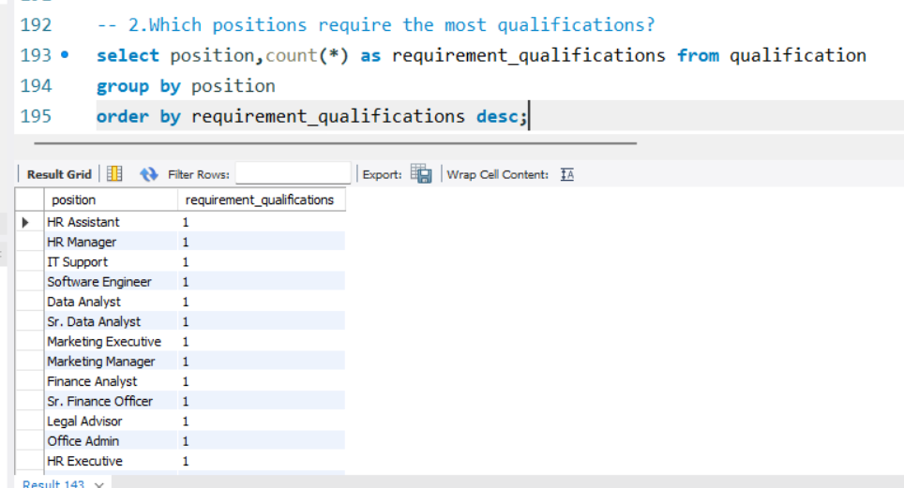
Which positions require the most qualifications?

Slide 14
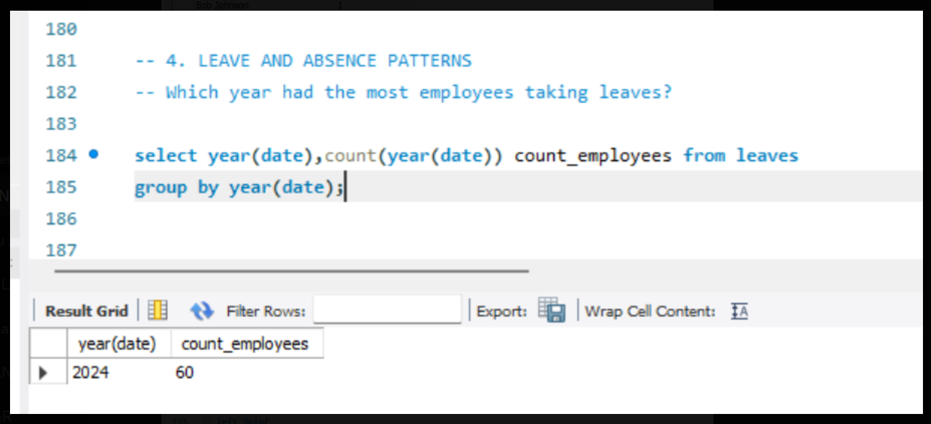
4. LEAVE AND ABSENCE PATTERNS Which year had the most employees taking leaves?

Slide 15
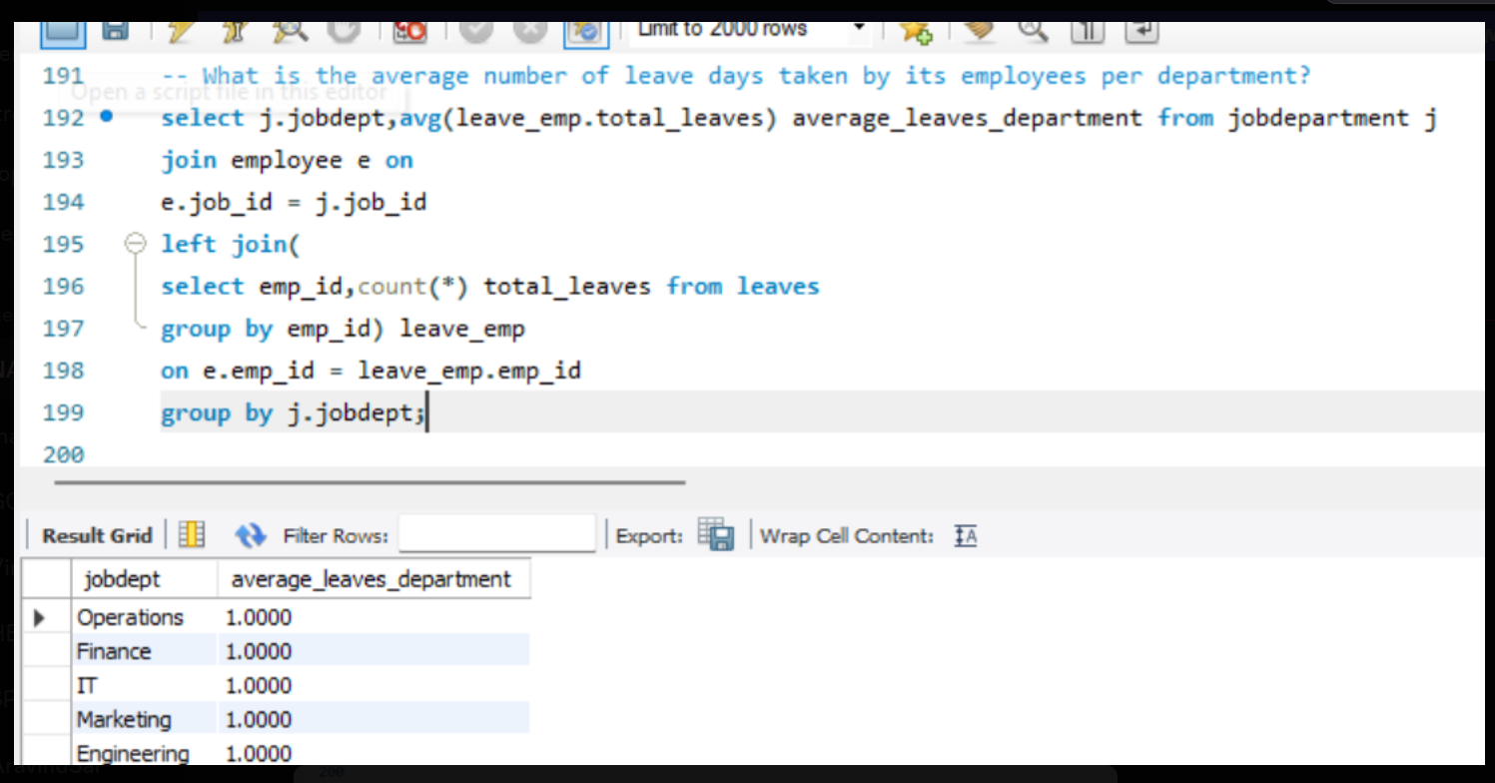
What is the average number of leave days taken by its employees per department?

Slide 16
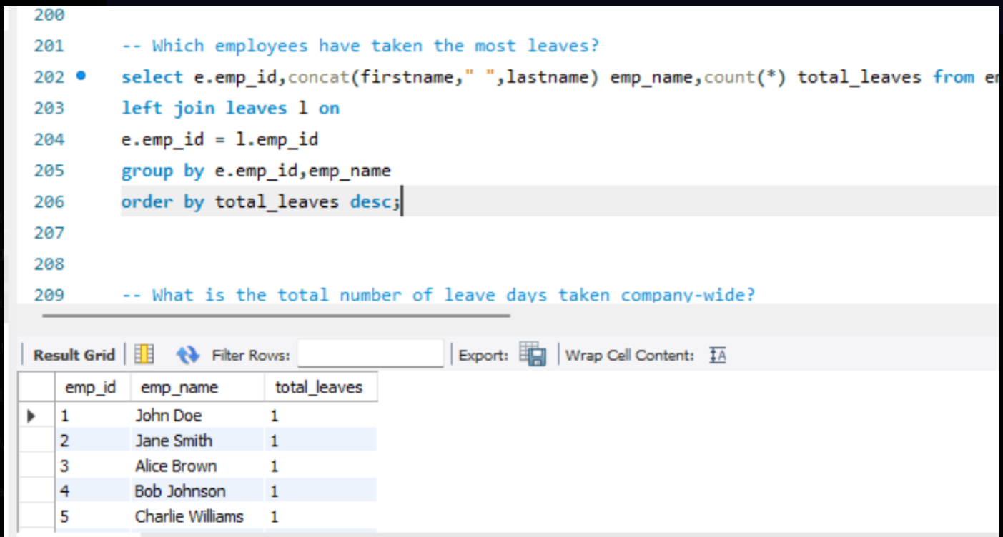
Which employees have taken the most leaves?

Slide 17
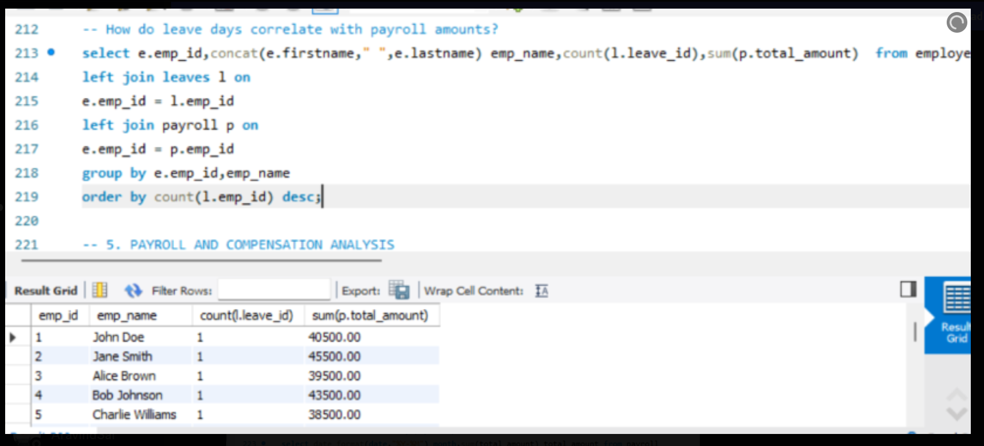
How do leave days correlate with payroll amounts?

Slide 18
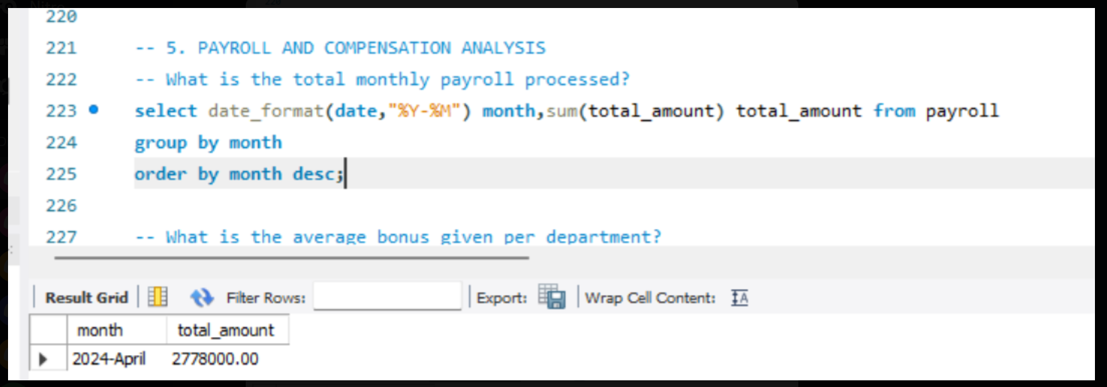
5. PAYROLL AND COMPENSATION ANALYSIS
What is the total monthly payroll processed?

Slide 19
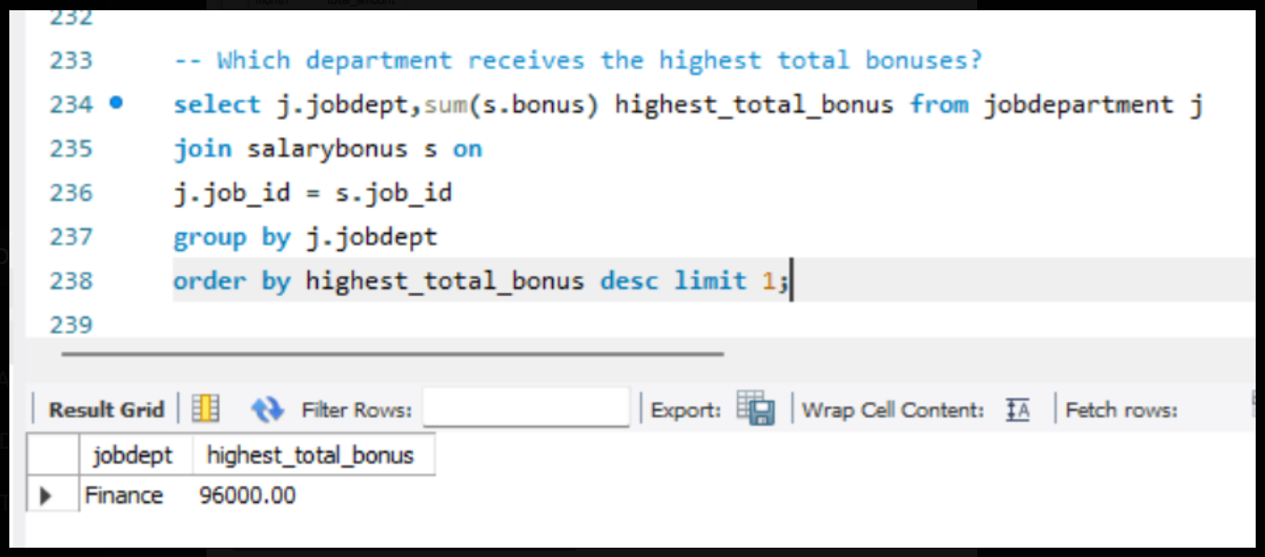
Which department receives the highest total bonuses?

Slide 20
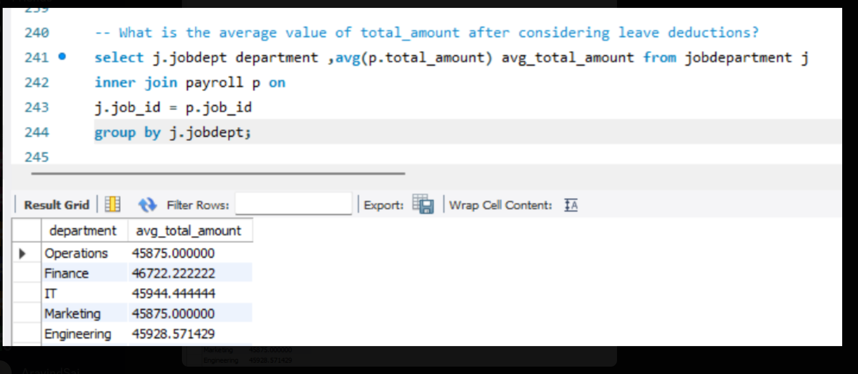
What is the average value of total_amount after considering leave deductions?

Slide 21
Conclusion (Key finding overall)
The database efficiently organizes employee, department , payroll, leave, and qualification data.
Salary and bonus analysis revealed key high-paying roles and departments with major expenditures.
Employee qualifications and leave patterns provide insights for training and workforce planning.
Payroll tracking ensures accurate compensation and highlights trends for financial planning.
Data-driven insights support better HR decisions, resource allocation, and employee management.
Overall, the system enables informed decision-making, improves operational efficiency, and enhances organizational performance.

Slide 22
Final business insights and recommendations:-
Departments with more employees may require additional resources and better management oversight.
Highest-paid roles indicate key positions; these employees should be retained and motivated.
Average salaries and total salary expenditures help in budget planning and financial forecasting.
Employees with multiple qualifications can be considered for promotions or critical projects.
Tracking leaves and absence patterns helps in workforce planning and minimizing productivity loss.
Payroll and bonus analysis can optimize compensation strategies and reward performance effectively.
Data-driven insights support HR decisions in recruitment, training, and role allocation.
Monitoring employee trends ensures better operational efficiency and organizational growth.

Slide 23
Challenges working on SQL – Data Analysis Project:-
Defining correct table relationships and ensuring accurate use of foreign keys.
Maintaining data consistency with cascading updates and deletes.
Writing complex joins for reports involving employee roles, leaves, and payroll.
Ensuring all date fields follow the YYYY-MM-DD format for reliable time-based analysis.
Preventing duplicate entries using unique constraints, especially on email fields.

Slide 24

THANK YOU

